Slide 1

System Design & Analysis
PHASE ONE
2.7.2004

Slide 2

Meet the team
PROJECT MANAGER
Adria Gratiot
PROGRAMMER
Matt Neiner
PROGRAMMER
Timothy Huffman
PROGRAMMER
Carl Samuels

Slide 3
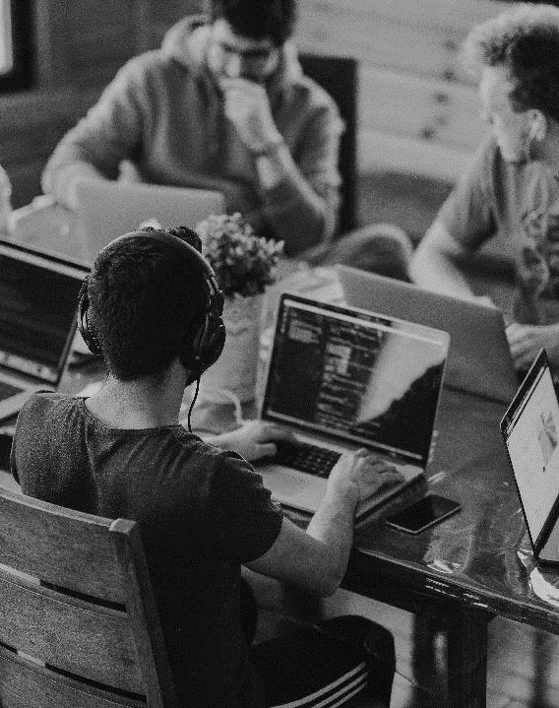
INTRODUCTION Project idea
PET NAMER
Would you like help picking a name for your pet?
Simply upload a picture and we’ll recommend a few different names for you!

Slide 4

Executive summary
Project proposal
After a client uploads a picture of their pet, our image recognition will be able to determine what kind of animal it is, then recommend names based off the animal’s species.

Slide 5
Components statement of work
Landing page with account creation
Picture upload screen
Picture recognition response
Name suggestions from designated databases based on the animal and obvious features

Slide 6

Frontend technology
HTML
CSS
Python 3.11.8

Slide 7
backend technology
VSCode IDE
Python 3.11.8
Django with SQL

Slide 8

Cutting edge APIs
CURRENTLY RESEARCHING
We need an API for animal photo recognition, here’s what we are looking at possibly implementing:
Amazon Rekognition
Imagga
The Dog API
Vision AI
KerasCV

Slide 9
Timeline & milestones
Phase 1 | Phase 2 | Phase 3 | Phase 4
February 7 | March 6 | April 10 | May 1
PROJECT SELECTED | FRONTEND DEVELOPMENT | BACKEND DEVELOPMENT | TESTING & ADJUSTMENT

Slide 10
THANK YOU
Team 1: Phase One

